Slide 1


ORGANIC CAFE
DATA ANALYSIS
TEBOGO SAKO

Slide 2

REVENUE ANALYSIS
R713K
R149k
9
TOTAL REVENUE
TOTAL ITEM SALES
TOTAL PRODUCTS

Slide 3
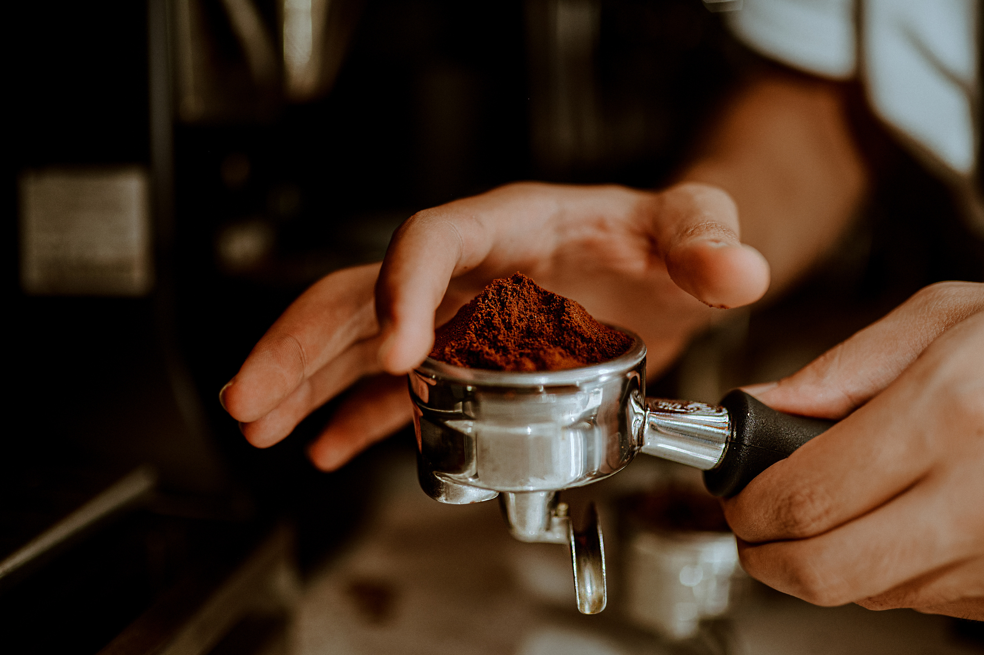
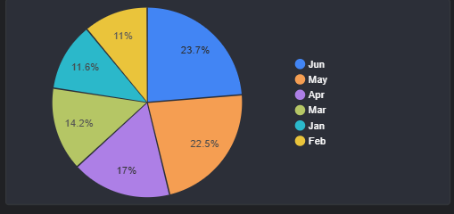
REVENUE PER MONTH
INSIGHTS
Sales performed exceptionally well in June compared to the other months, largely due to the seasonal shift into winter. May recorded the second-highest performance, followed closely by April.

Slide 4

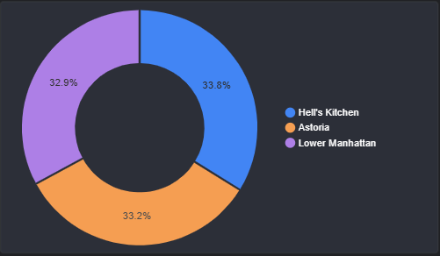
REVENUE PER LOCATION
INSIGHTS
Revenue distribution across the three store locations is relatively balanced, with Hell’s Kitchen contributing 33.8%, Astoria accounting for 33.2%, and Lower Manhattan generating 32.9% of total revenue. This close distribution indicates consistent performance across all stores

Slide 5
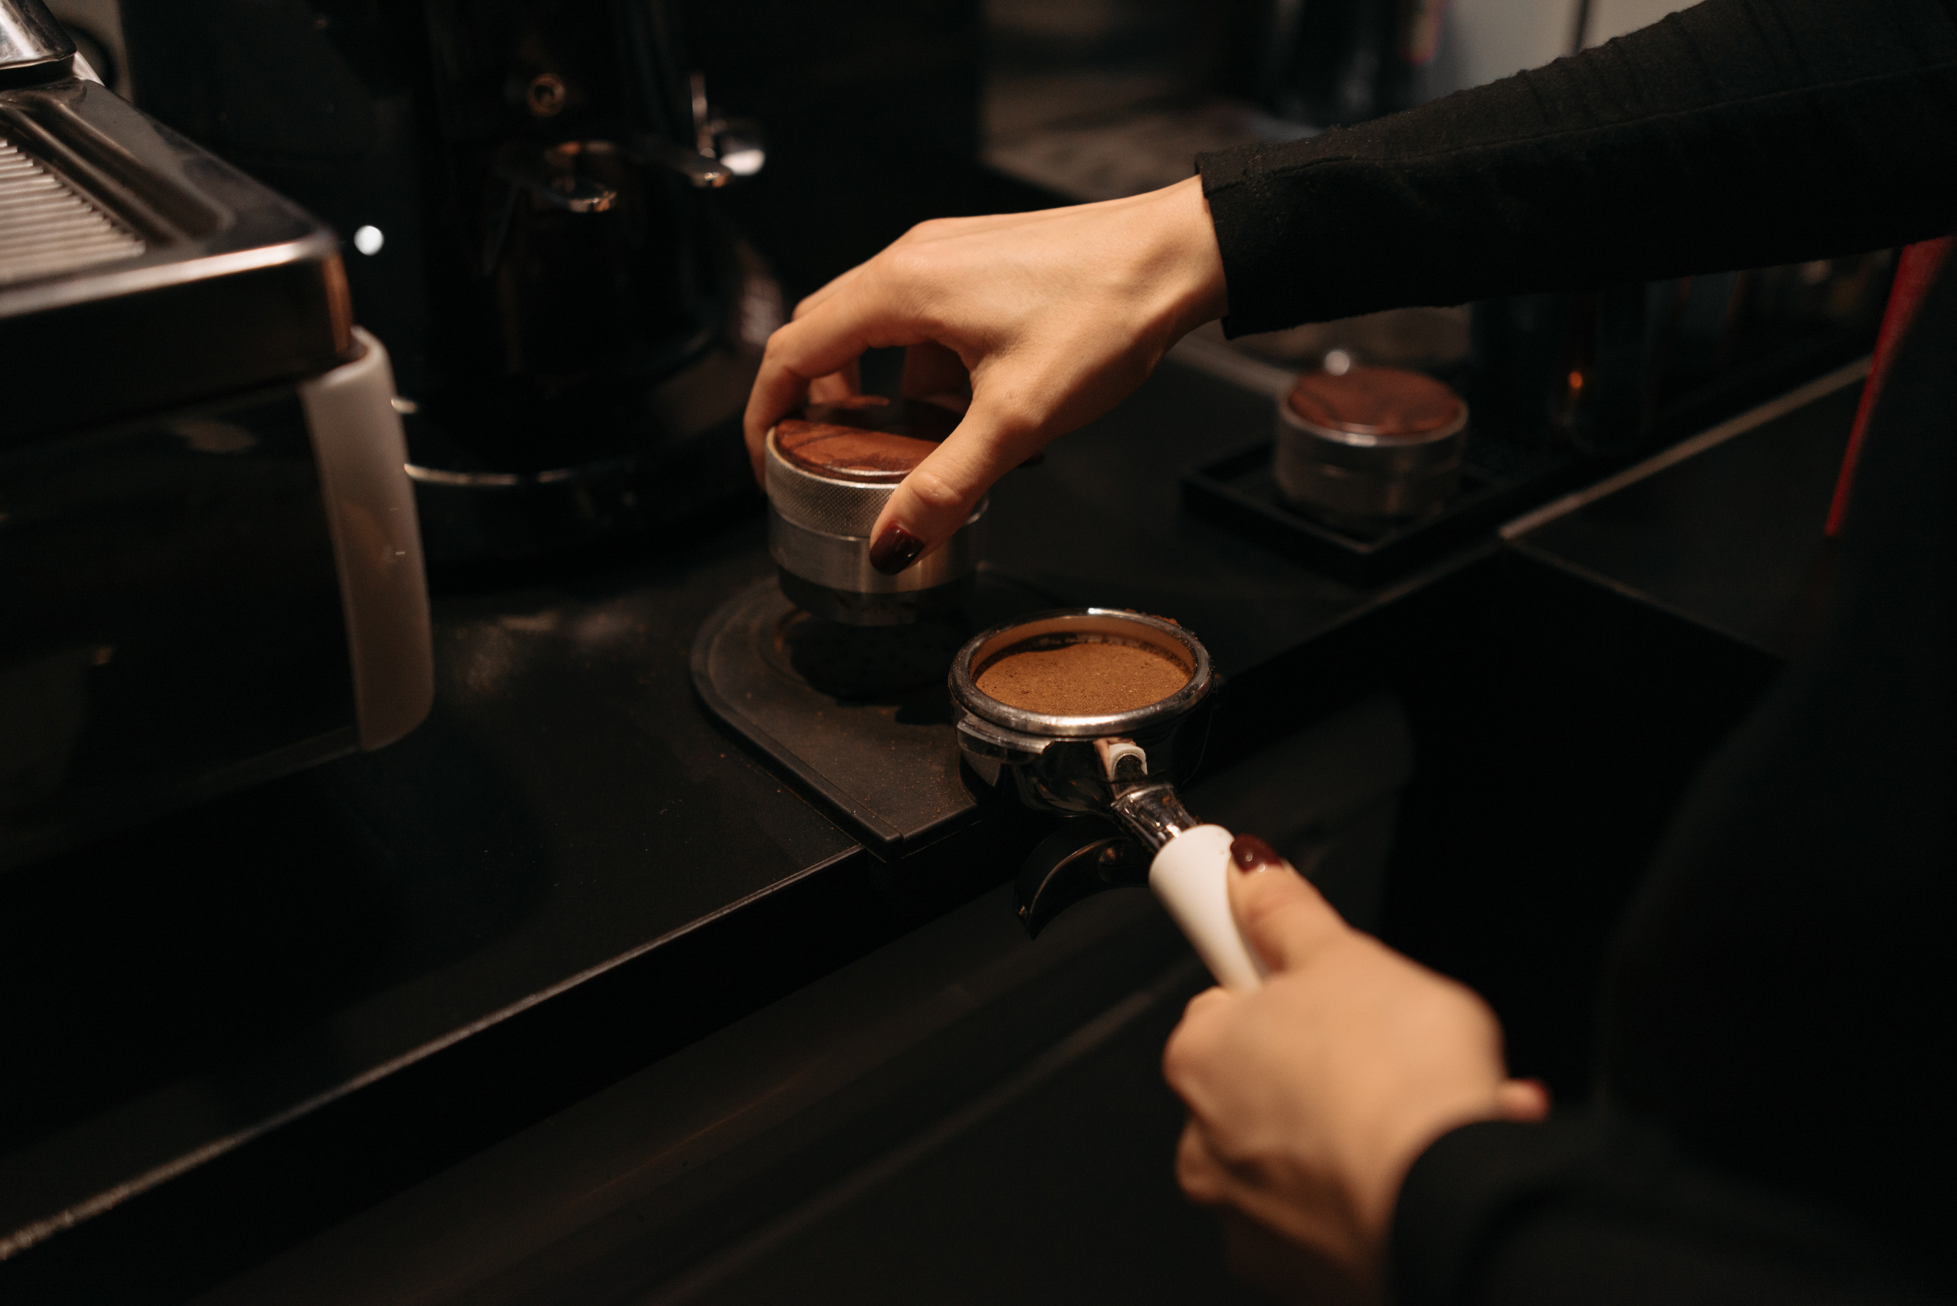
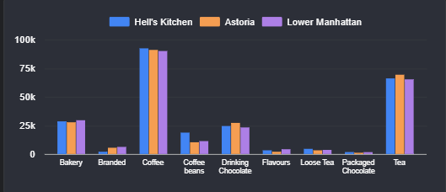
REVENUE BY PRODUCT CATEGORY
INSIGHTS
Coffee consistently emerges as the highest performing category across all three stores, indicating strong and stable customer demand. Tea follows as the second best performing category, suggesting a clear preference for hot beverages.
Baked goods rank third, highlighting their role as a complementary, rather than primary, revenue driver.

Slide 6

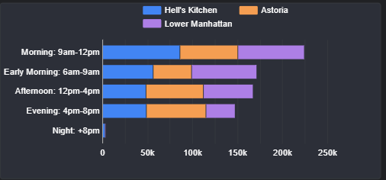

REVENUE BY TIME
INSIGHTS
Sales peak during the mid-morning period, indicating this as the primary revenue-generating time of day. Early morning follows as the second-highest performing period, with afternoon sales remaining competitive. Evening sales show a noticeable decline, while nighttime consistently records the lowest sales, highlighting reduced customer activity during late hours.

Slide 7

RECOMMENDATIONS
Introduce cold beverages sch as Iced latte, iced tea, matcha to improve revenue in the hotter months
Improve marketing for all three stores to improve visibility and customer engagement
Create product campaigns for categories that are contributing the least to the total revenue
Develop night -time specials to improve sales in the night-time period

Slide 8

THANK YOU

